Slide 1
Product Rule

Slide 2

If $p\left(x\right)=f\left(x\right)g(x)$, then
$p^{′}\left(x\right)=f^{′}\left(x\right)g\left(x\right)+f\left(x\right)g′(x)$
$\frac{d}{dx}\left(uv\right)=\left(\frac{du}{dx}\right)v+u\left(\frac{dv}{dx}\right)$
Product Rule in Newton notation
Product Rule in Leibniz notation

Slide 3

Proof
Let $p\left(x\right)=f\left(x\right)g(x)$
$p^{′}\left(x\right)=\begin{matrix}lim⁡ \\ h→0\end{matrix} \frac{p\left(x+h\right)−p(x)}{h}$
$p^{′}\left(x\right)=\begin{matrix}lim⁡ \\ h→0\end{matrix} \frac{f\left(x+h\right)g\left(x+h\right)−f\left(x\right)g(x)}{h}$
Differentiate $p(x)$ using first principles
Since $p\left(x\right)=f\left(x\right)g(x)$, therefore $p\left(x+h\right)=f\left(x+h\right)g(x+h)$
Next, we will add 0 in the middle of the numerator

Slide 4

$p^{′}\left(x\right)=\begin{matrix}lim⁡ \\ h→0\end{matrix} \frac{f\left(x+h\right)g\left(x+h\right)+0−f\left(x\right)g(x)}{h}$
$p^{′}\left(x\right)=\begin{matrix}lim⁡ \\ h→0\end{matrix} \frac{f\left(x+h\right)g\left(x+h\right)−f\left(x\right)g\left(x+h\right)+f\left(x\right)g(x+h)−f\left(x\right)g(x)}{h}$
Sub in $−f\left(x\right)g\left(x+h\right)+f\left(x\right)g(x+h)$ for 0

Slide 5
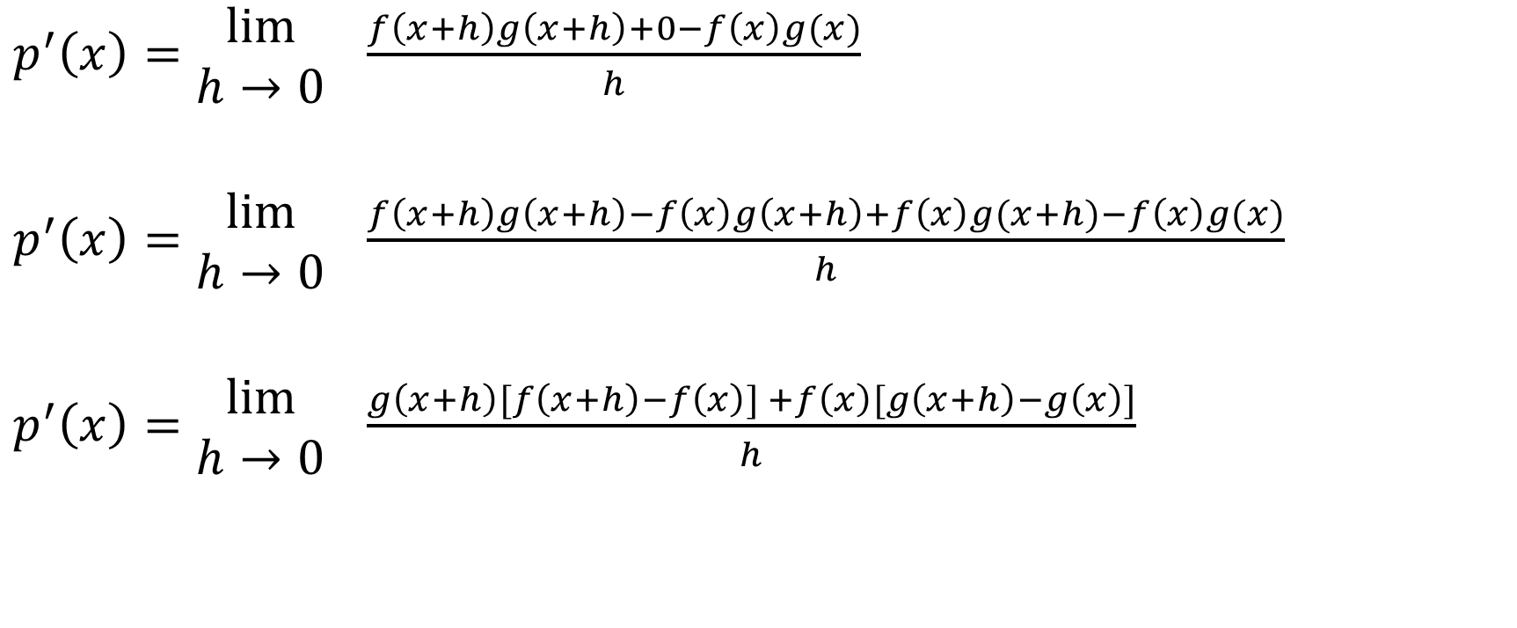
$p^{′}\left(x\right)=\begin{matrix}lim⁡ \\ h→0\end{matrix} \frac{f\left(x+h\right)g\left(x+h\right)+0−f\left(x\right)g(x)}{h}$
$p^{′}\left(x\right)=\begin{matrix}lim⁡ \\ h→0\end{matrix} \frac{f\left(x+h\right)g\left(x+h\right)−f\left(x\right)g\left(x+h\right)+f\left(x\right)g(x+h)−f\left(x\right)g(x)}{h}$
$p^{′}\left(x\right)=\begin{matrix}lim⁡ \\ h→0\end{matrix} \frac{g\left(x+h\right)[f\left(x+h\right)−f\left(x\right)] +f\left(x\right)[g\left(x+h\right)−g\left(x\right)]}{h}$
Sub in $−f\left(x\right)g\left(x+h\right)+f\left(x\right)g(x+h)$ for 0
Next, we will factor $g(x+h)$ from the first two terms and we will factor $f(x)$ from the next two terms.
Split into two fractions

Slide 6
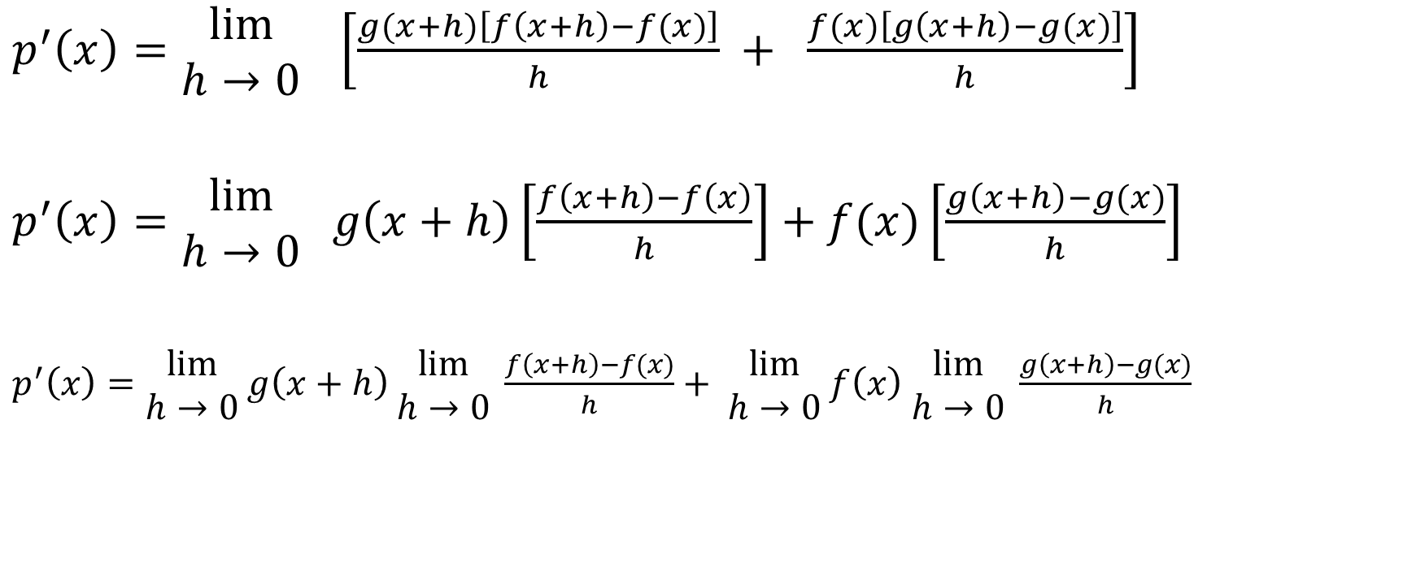
$p^{′}\left(x\right)=\begin{matrix}lim⁡ \\ h→0\end{matrix} \left[\frac{g(x+h)\left[f\left(x+h\right)−f(x)\right]}{h} + \frac{f(x)\left[g\left(x+h\right)−g(x)\right]}{h}\right]$
$p^{′}\left(x\right)=\begin{matrix}lim⁡ \\ h→0\end{matrix} g\left(x+h\right)\left[\frac{f\left(x+h\right)−f\left(x\right)}{h}\right]+f(x)\left[\frac{g\left(x+h\right)−g(x)}{h}\right]$
$p^{′}\left(x\right)=\begin{matrix}lim⁡ \\ h→0\end{matrix} g\left(x+h\right) \begin{matrix}lim⁡ \\ h→0\end{matrix} \frac{f\left(x+h\right)−f(x)}{h}+ \begin{matrix}lim⁡ \\ h→0\end{matrix} f\left(x\right) \begin{matrix}lim⁡ \\ h→0\end{matrix} \frac{g\left(x+h\right)−g(x)}{h}$
Pull the factor $g(x+h)$ in front of the first fraction and pull the factor $f(x)$ in front of the second fraction.
Distribute the limit notation

Slide 7



$p^{′}\left(x\right)=\begin{matrix}lim⁡ \\ h→0\end{matrix} g\left(x+h\right) \begin{matrix}lim⁡ \\ h→0\end{matrix} \frac{f\left(x+h\right)−f(x)}{h}+ \begin{matrix}lim⁡ \\ h→0\end{matrix} f\left(x\right) \begin{matrix}lim⁡ \\ h→0\end{matrix} \frac{g\left(x+h\right)−g(x)}{h}$
$g\left(x+0\right)=g(x)$

Slide 8


$p^{′}\left(x\right)=\begin{matrix}lim⁡ \\ h→0\end{matrix} g\left(x+h\right) \begin{matrix}lim⁡ \\ h→0\end{matrix} \frac{f\left(x+h\right)−f(x)}{h}+ \begin{matrix}lim⁡ \\ h→0\end{matrix} f\left(x\right) \begin{matrix}lim⁡ \\ h→0\end{matrix} \frac{g\left(x+h\right)−g(x)}{h}$
$f′(x)$

Slide 9


$p^{′}\left(x\right)=\begin{matrix}lim⁡ \\ h→0\end{matrix} g\left(x+h\right) \begin{matrix}lim⁡ \\ h→0\end{matrix} \frac{f\left(x+h\right)−f(x)}{h}+ \begin{matrix}lim⁡ \\ h→0\end{matrix} f\left(x\right) \begin{matrix}lim⁡ \\ h→0\end{matrix} \frac{g\left(x+h\right)−g(x)}{h}$
There is no h in this expression, so the expression equals $f(x)$

Slide 10


$p^{′}\left(x\right)=\begin{matrix}lim⁡ \\ h→0\end{matrix} g\left(x+h\right) \begin{matrix}lim⁡ \\ h→0\end{matrix} \frac{f\left(x+h\right)−f(x)}{h}+ \begin{matrix}lim⁡ \\ h→0\end{matrix} f\left(x\right) \begin{matrix}lim⁡ \\ h→0\end{matrix} \frac{g\left(x+h\right)−g(x)}{h}$
$g′(x)$

Slide 11

$p^{′}\left(x\right)=\begin{matrix}lim⁡ \\ h→0\end{matrix} g\left(x+h\right) \begin{matrix}lim⁡ \\ h→0\end{matrix} \frac{f\left(x+h\right)−f(x)}{h}+ \begin{matrix}lim⁡ \\ h→0\end{matrix} f\left(x\right) \begin{matrix}lim⁡ \\ h→0\end{matrix} \frac{g\left(x+h\right)−g(x)}{h}$
$p^{′}\left(x\right)=g\left(x\right)f^{′}\left(x\right)+f\left(x\right)g′(x)$
Rearrange factors
$p^{′}\left(x\right)=f′(x)g\left(x\right)+f\left(x\right)g′(x)$

Slide 12

Example
Differentiate $h\left(x\right)=\left(x^{3}−2x\right)\left(3x^{4}+2x+8\right)$

Slide 13

Differentiate $h\left(x\right)=\left(x^{3}−2x\right)\left(3x^{4}+2x+8\right)$
Solution:
$h^{′}\left(x\right)=\left(3x^{2}−2\right)\left(3x^{4}+2x+8\right)+\left(x^{3}−2x\right)\left(3x^{4}+2x+8\right)$

Slide 14

Example
Determine the value of $f′(−$ 1) given that
$f\left(x\right)=\left(3x^{4}−12x^{2}+4x−9\right)\left(6x^{7}−4x^{4}+18\right)$

Slide 15
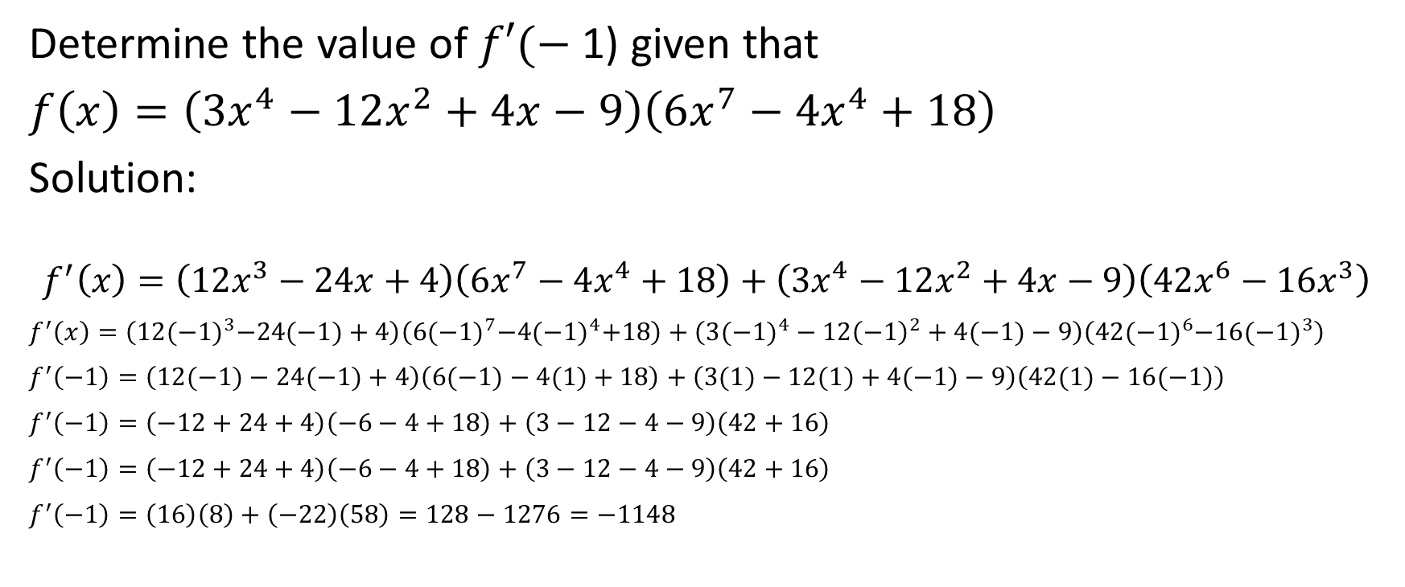
Determine the value of $f′(−$ 1) given that
$f\left(x\right)=\left(3x^{4}−12x^{2}+4x−9\right)\left(6x^{7}−4x^{4}+18\right)$
Solution:
$$f^{′}\left(x\right)=\left(12x^{3}−24x+4\right)\left(6x^{7}−4x^{4}+18\right)+\left({3x}^{4}−12x^{2}+4x−9\right)\left(42x^{6}−16x^{3}\right)$$
$f^{′}\left(x\right)=\left(12{(−1)}^{3}−24(−1)+4\right)\left(6{(−1)}^{7}−4{(−1)}^{4}+18\right)+\left({3(−1)}^{4}−12{\left(−1\right)}^{2}+4(−1)−9\right)\left(42{(−1)}^{6}−16{(−1)}^{3}\right)$
$f^{′}\left(−1\right)=\left(12(−1)−24(−1)+4\right)\left(6(−1)−4(1)+18\right)+\left(3(1)−12(1)+4(−1)−9\right)\left(42(1)−16(−1)\right)$
$f^{′}\left(−1\right)=\left(−12+24+4\right)\left(−6−4+18\right)+\left(3−12−4−9\right)\left(42+16\right)$
$f^{′}\left(−1\right)=\left(−12+24+4\right)\left(−6−4+18\right)+\left(3−12−4−9\right)\left(42+16\right)$
$f^{′}\left(−1\right)=\left(16\right)\left(8\right)+\left(−22\right)\left(58\right)=128−1276=−1148$

Slide 16

Determine the value of $f′(−$ 1) given that
$f\left(x\right)=\left(3x^{4}−12x^{2}+4x−9\right)\left(6x^{7}−4x^{4}+18\right)$
Solution:
Therefore, $f^{′}\left(−1\right)=−1148$

Slide 17

Example
Determine the value of $f′(1$) given that
$$f\left(x\right)={\left(4x^{2}−3x+1\right)}^{7}$$

Slide 18

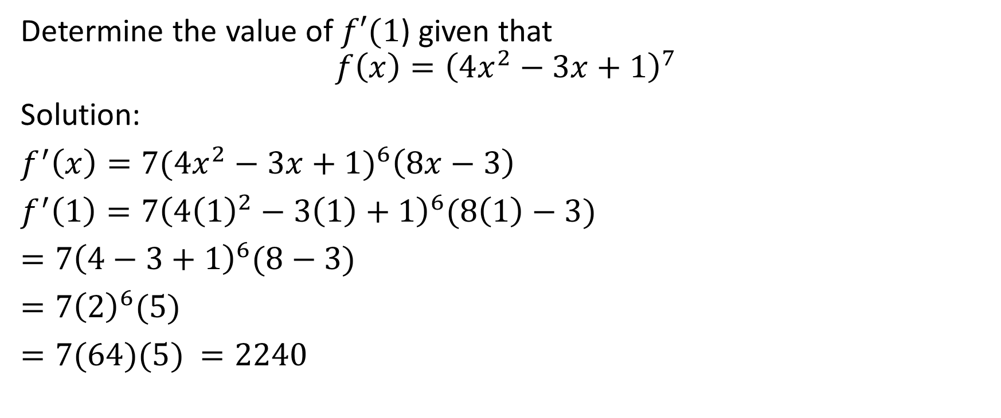
Determine the value of $f′(1$) given that
$$f\left(x\right)={\left(4x^{2}−3x+1\right)}^{7}$$
Solution:
$f^{′}\left(x\right)=7{(4x^{2}−3x+1)}^{6}\left(8x−3\right)$
$f^{′}\left(1\right)=7{\left(4{\left(1\right)}^{2}−3\left(1\right)+1\right)}^{6}(8\left(1\right)−3)$
$=7{\left(4−3+1\right)}^{6}(8−3)$
$=7{\left(2\right)}^{6}(5)$
$=7(64)(5)$ $=2240$
Therefore, $f^{′}\left(1\right)=2240$

Slide 19
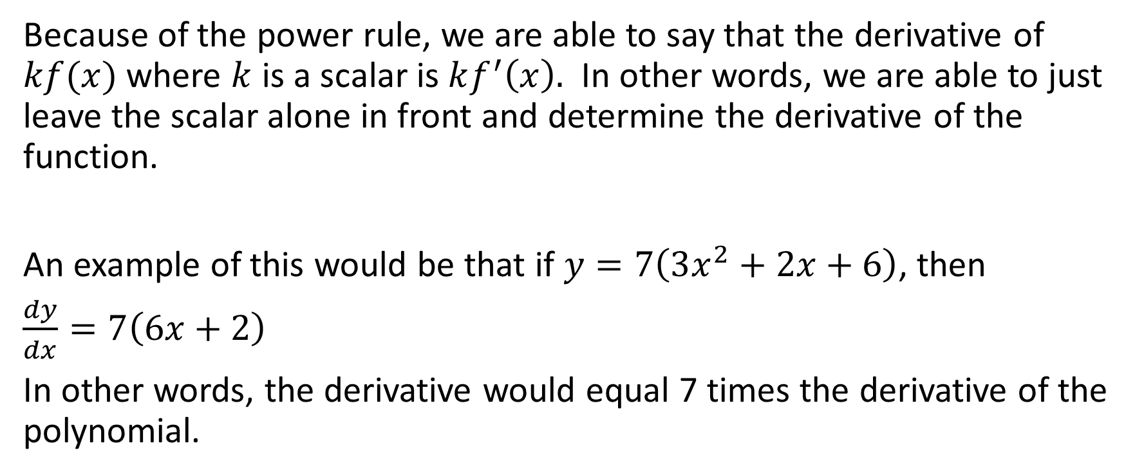
Because of the power rule, we are able to say that the derivative of $kf(x)$ where $k$ is a scalar is $kf^{′}\left(x\right).$ In other words, we are able to just leave the scalar alone in front and determine the derivative of the function.
An example of this would be that if $y=7\left(3x^{2}+2x+6\right)$, then
$\frac{dy}{dx}=7\left(6x+2\right)$
In other words, the derivative would equal 7 times the derivative of the polynomial.

Slide 20
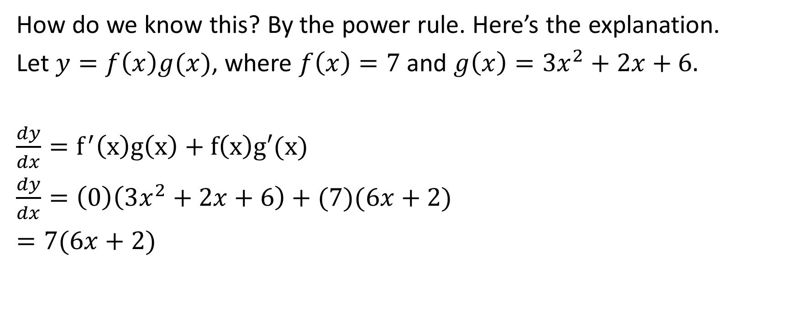
How do we know this? By the power rule. Here’s the explanation.
Let $y=f\left(x\right)g(x)$, where $f\left(x\right)=7$ and $g\left(x\right)=3x^{2}+2x+6.$
$\frac{dy}{dx}=f^{′}\left(x\right)g\left(x\right)+f\left(x\right)g′(x)$
$\frac{dy}{dx}=\left(0\right)\left(3x^{2}+2x+6\right)+(7)(6x+2)$
$=7(6x+2)$

